Slide 1
Presumptive Diagnosis and Awareness for STDs via Mobile Devices
Byungho Lee
Fourth Sector Innovations

Slide 2
Cambodians are getting Wired!
“the Facebook Vote” – Global Voice
“Cambodia Election proves Facebook more than just a Social Network” – Asian Correspondents
“Virtual Democracy” – Southeast Asia Globe Magazine

Slide 3
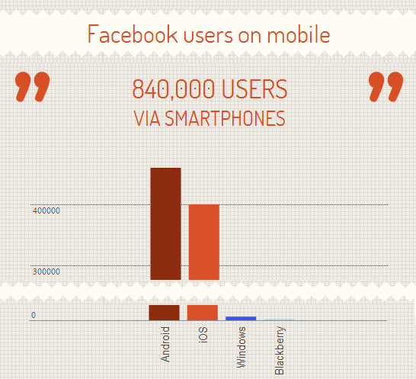
Cambodians are getting Wired!

Slide 4
3g/Wifi enabled Mobile Devices for Health Care
Provide Privacy of users
Focused information and knowledge
Easy to use via simple but elegant UX design
Use Videos, Pictures and Photos
Localized for Cambodians
Create needed DB for public sharing

Slide 5
3g/Wifi enabled Mobile Devices for Health Care
Can Android/iOS app help rural Cambodians?
Mobility of urban Cambodians
Providing tools for health care workers

Slide 6
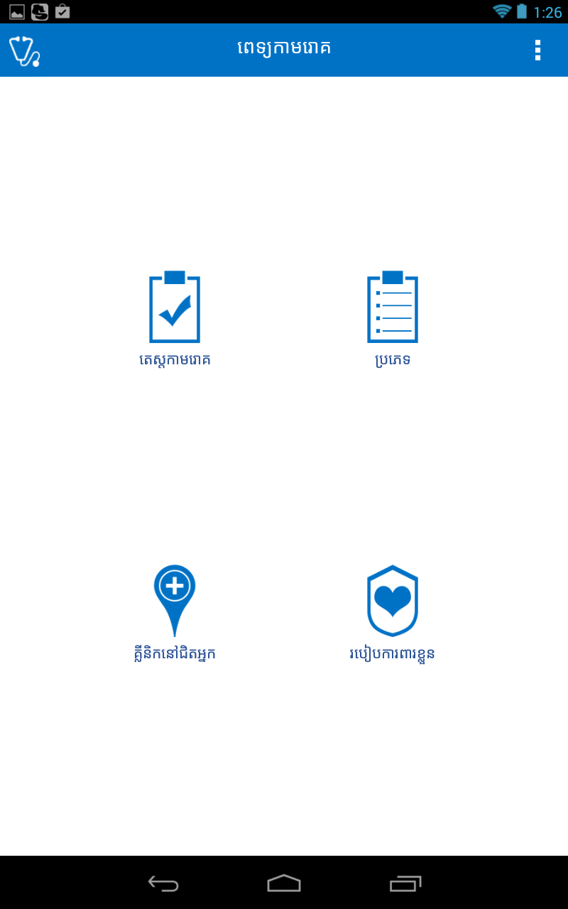
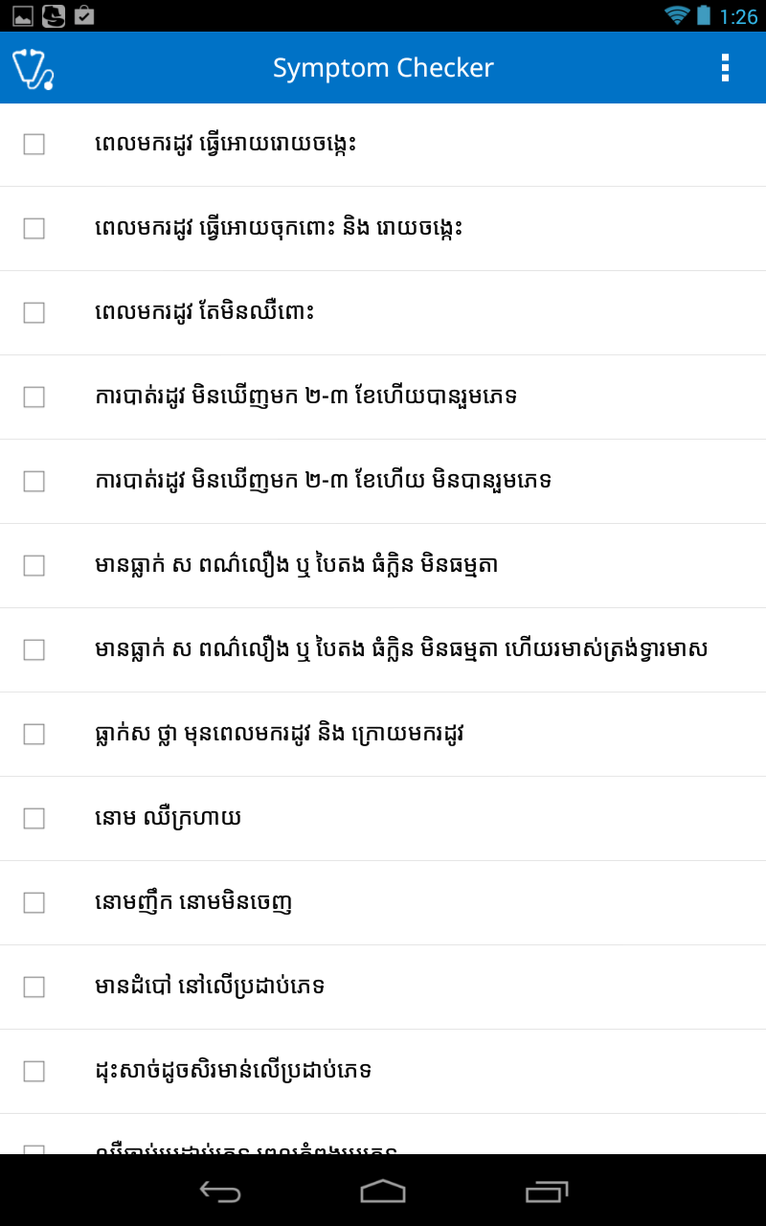
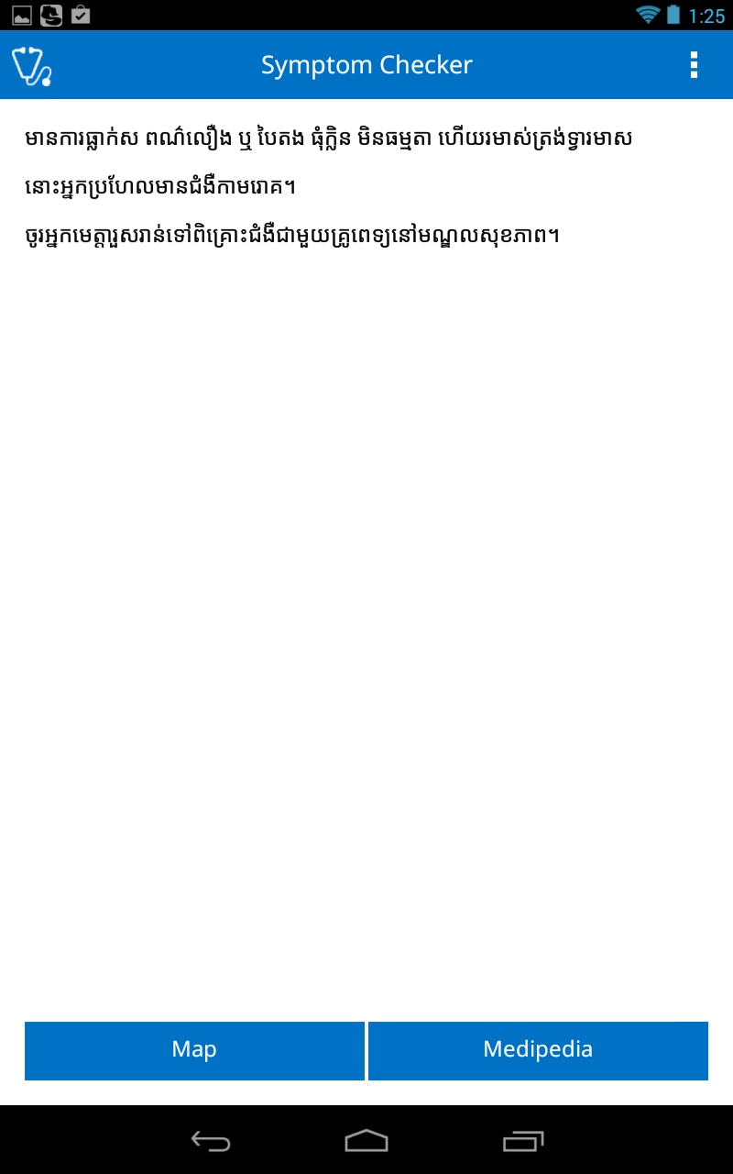
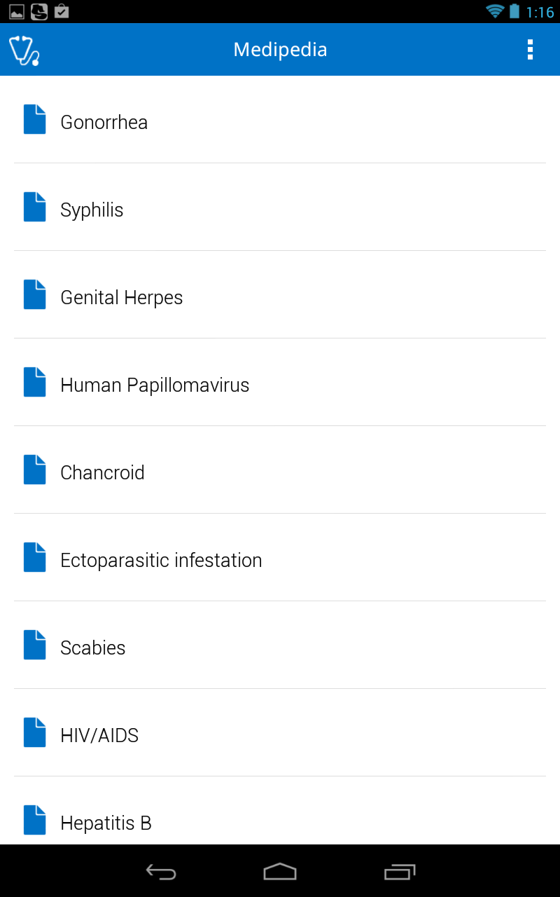
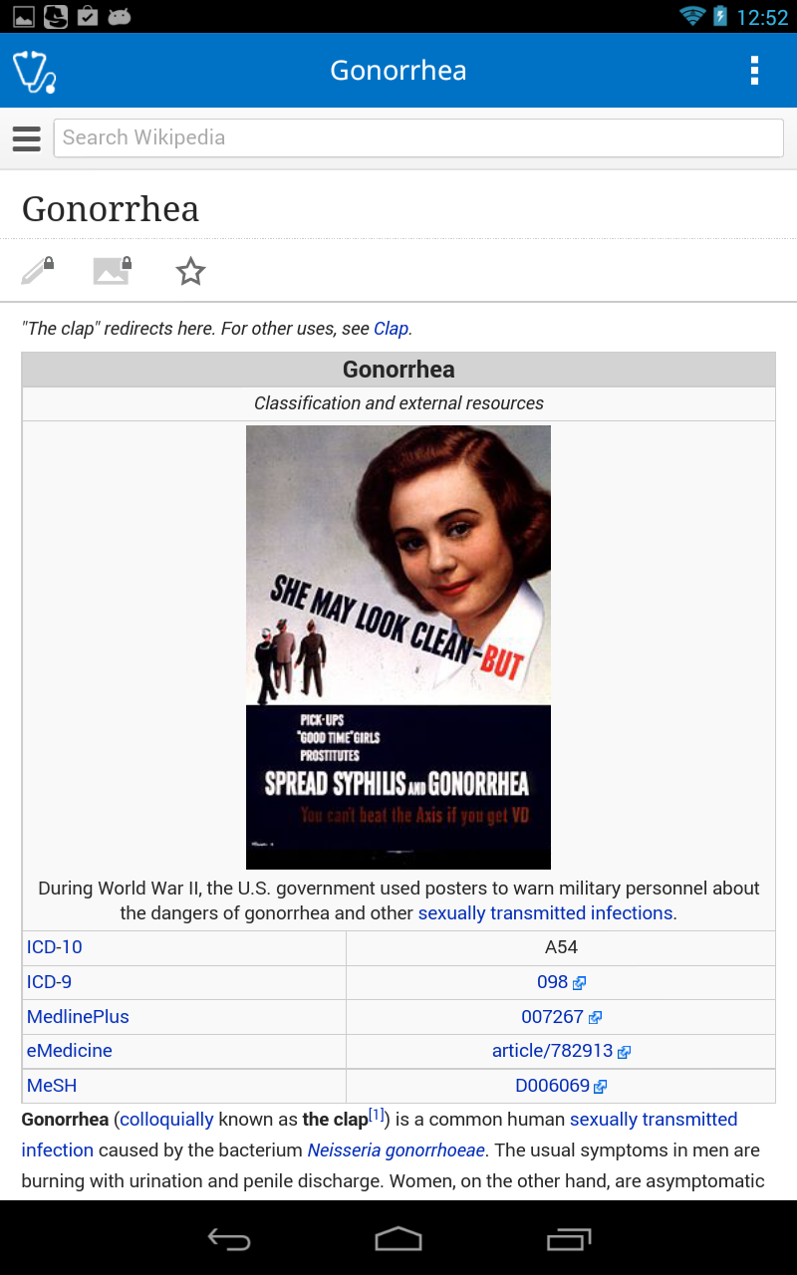
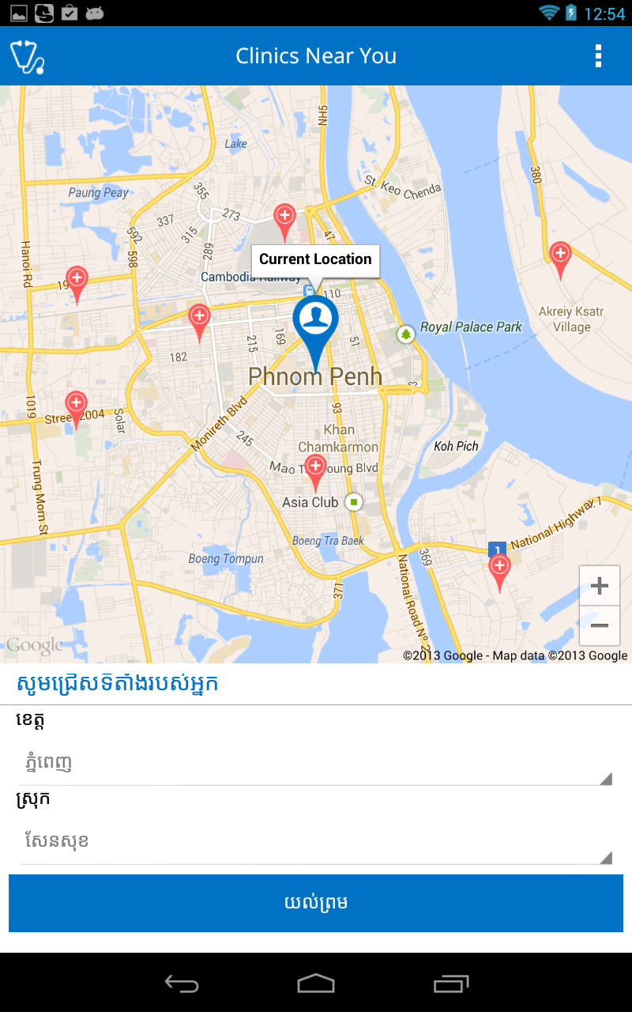
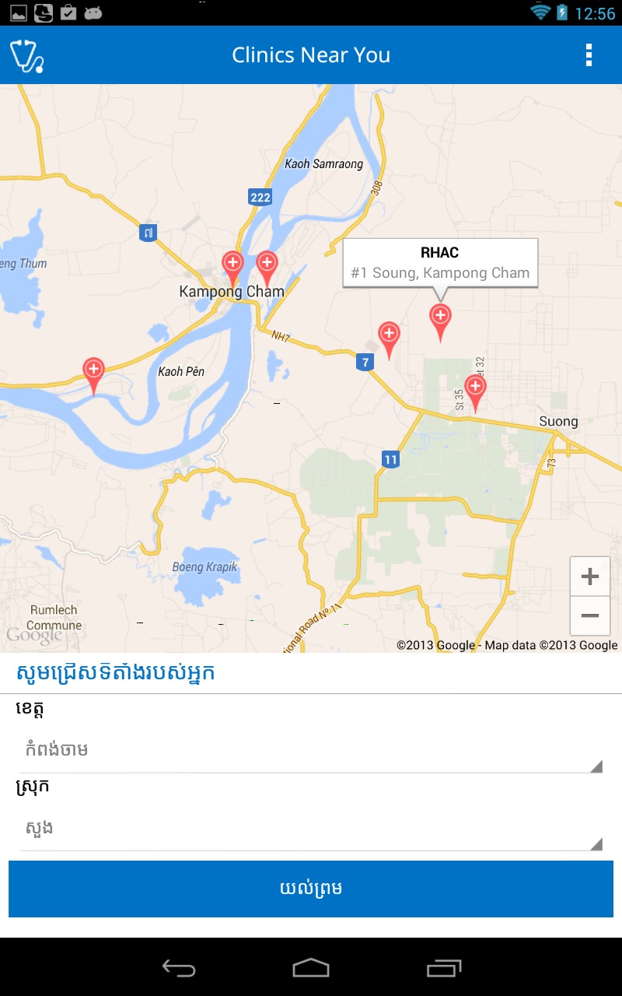
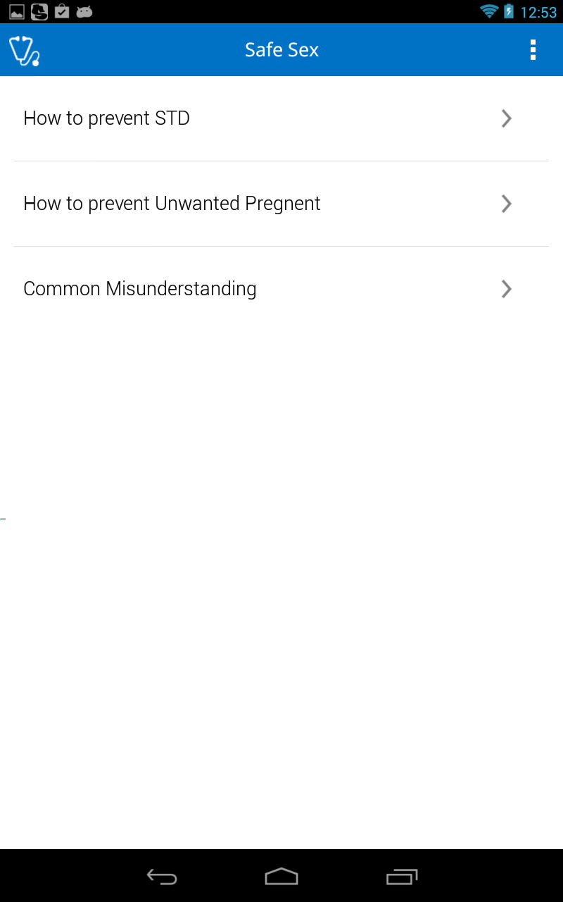
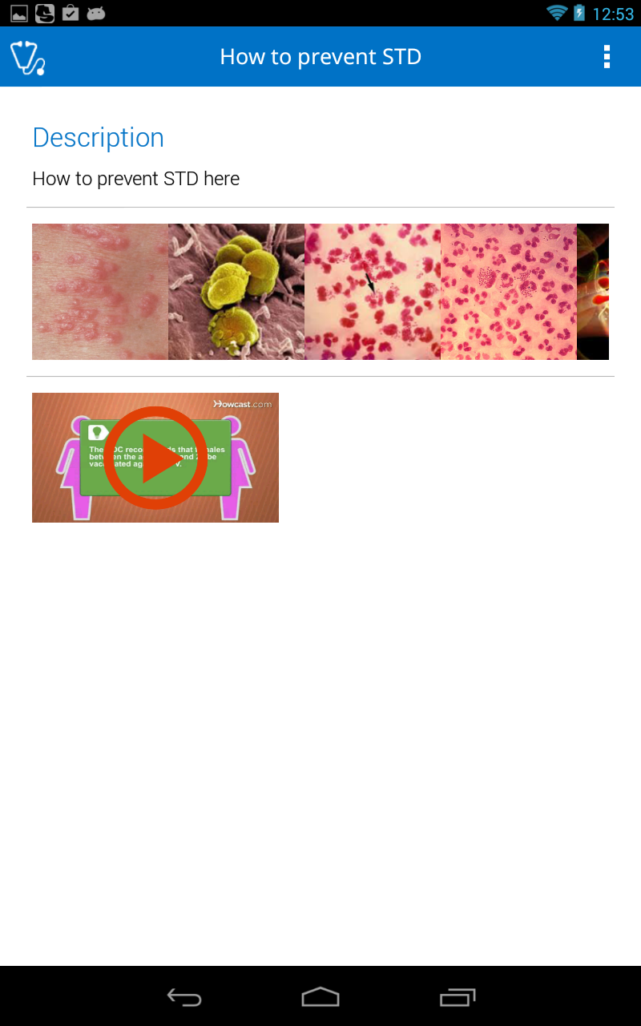
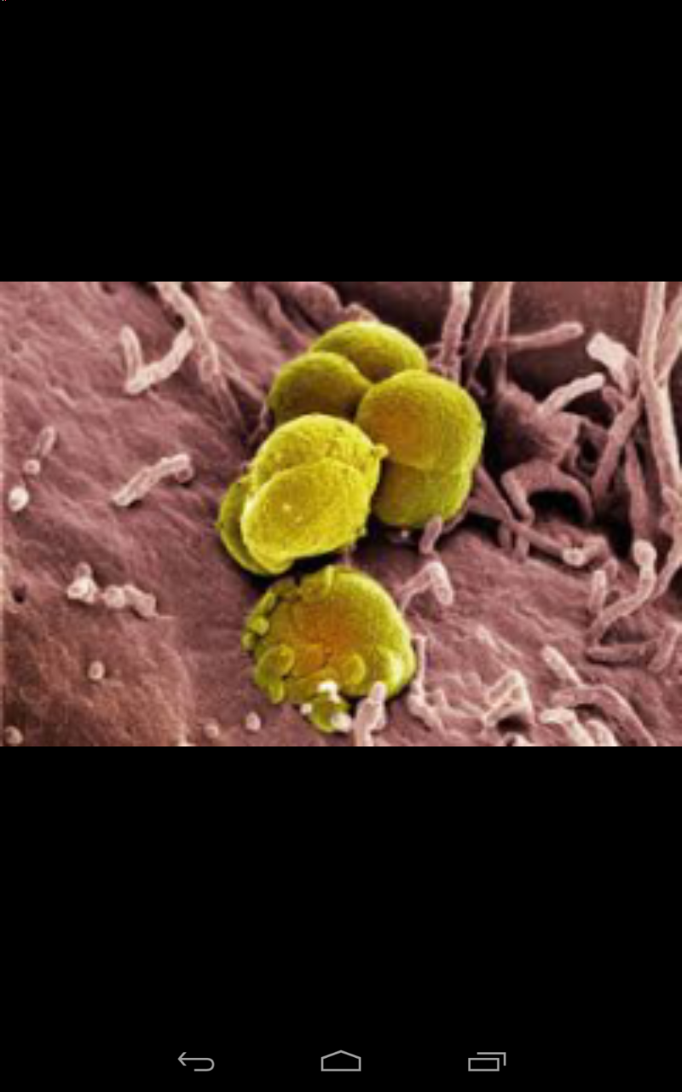
STD Education Android app Pet Kamrok

Slide 7
Coming up!
Anonymous usage Data for detecting regional epidemics
Health Care Apps for Women and Children
More Public Health Care related DB
More Multimedia files for education
Internationalization for other 3rd world countries

Slide 8
Q&A
Presented by
Royal University of Phnom Penh
Fourth Sector Innovations
A Software Development Social Enterprise in Cambodia

